Slide 1

INTRODUCTION TO APPLIED STATITICS
TIMES PRO _ PROFESSIONAL LEARNING

Slide 2
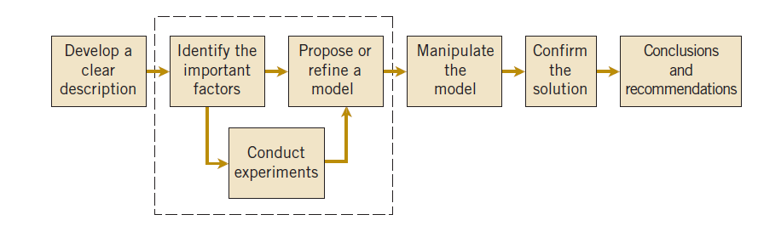
The Creative Process & Statistics Supports
Figure The engineering method
The field of statistics deals with the collection, presentation, analysis, and use of data to:
  Make decisions
  Solve problems
  Design products and processes
It is the science of learning information from data.
TIMES PRO _ PROFESSINAL LEARNING

Slide 3
Descriptive & Inferential Statistics
Descriptive Statistics
Organize
Summarize
Simplify
Presentation of data
Inferential Statistics
Generalize from samples to pops
Hypothesis testing
Relationships among variables
Describing data
Make predictions
Notes:
Automobile company sales report,, car milage report
QM-120, M. Zainal

Slide 4
Descriptive Statistics
3 Types
1. Frequency Distributions
3. Summary Stats
Creating freqiuencies
Describe data in just one
number
2. Graphical Representations
Graphs & Tables

Slide 5
Eg: Frequency Distributions
How many males and how many females are
in our class?
total
Frequency
(%)
? ?
?/tot x 100 ?/tot x 100
-----% ------%

Slide 6
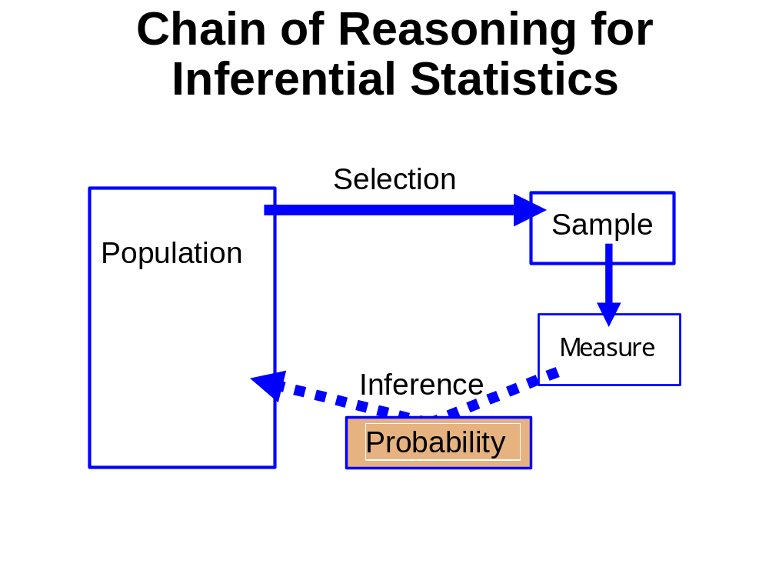
data

Slide 7
Inferential Statistics
Sample
Sample
Population
Sample
Sample
Draw inferences about the
larger group

Slide 8
Basic Parameter
Measures of variability
typical average variation
Measures of central tendency
typical average score
Range: distance from the lowest to the highest (use 2 data points)
2. Variance: (use all data points)
3. Standard Deviation
4. Standard Error of the Mean
Notes:
VARAIBILITY OF PRICING OF PRODUCT
QM-120, M. Zainal

Slide 9
Measures of Central Tendency
Quantitative data:
  Mode – the most frequently occurring observation
  Median – the middle value in the data (50 50 )
  Mean – arithmetic average

Slide 10

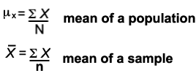
Mean
Notation
The most common and most useful average
Mean = sum of all observations
number of all observations
Observations can be added in any order.
Sample vs population
Sample mean = X
Population mean =μ
Summation sign =
Sample size = n
Population size = N

Slide 11
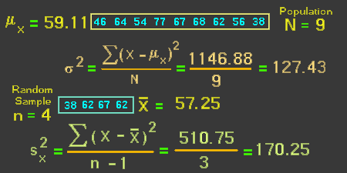
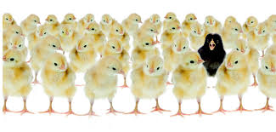
Measures of Variability
Νotation for variance
s²

Slide 12
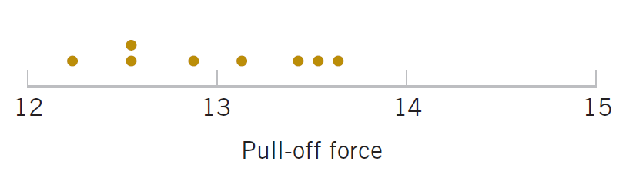
Engineering Example of Variability
Eight prototype cars with economy measure milage (KMPL)are produced
12.6, 12.9, 13.4, 12.3, 13.6, 13.5, 12.6, 13.1.
All of the prototypes does not have the same milage. We can see the variability in the above measurements as they exhibit variability.
The dot diagram is a very useful plot for displaying a small body of data - say up to about 20 observations.
This plot allows us to see easily two features of the data; the location, or the middle, and the scatter or variability.
TIMES PRO _ PROFESSINAL LEARNING

Slide 13
Hypothesis Test
Hypothesis Test
  A statement about a process behavior value.
  Compared to a claim about another process value.
  Data is gathered to support or refuse the claim.
One-sample hypothesis test:
  Example: Ford avg mpg = 30
  vs
  Ford avg mpg < 30
Two-sample hypothesis test:
  Example: Ford avg mpg – Chevy avg mpg = 0
  vs
  Ford avg mpg – Chevy avg mpg > 0
TIMES PRO _ PROFESSINAL LEARNING

Slide 14
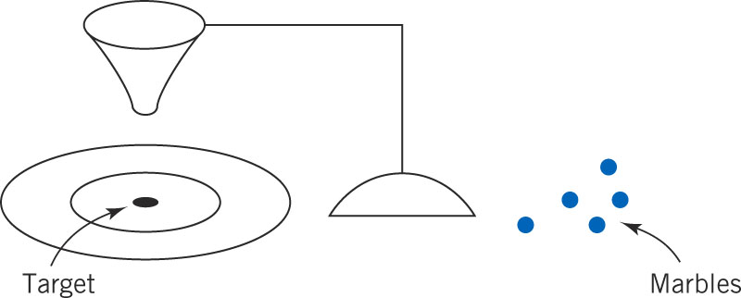
Deming’s Experiment in Variation
W. Edwards Deming, a famous industrial statistician & contributor to the Japanese quality revolution, conducted a illustrative experiment on process over-control or tampering.
Marbles were dropped through a funnel onto a target and the location where the marble struck the target was recorded.
Variation was caused by several factors:
Marble placement in funnel & release dynamics, vibration, air currents, measurement errors.
  Figure 1-10 Deming’s Funnel experiment
  Figure Deming’s Funnel experiment
TIMES PRO _ PROFESSINAL LEARNING

Slide 15
Experimental Procedure
The funnel was aligned with the center of the target. Marbles were dropped. The distance from the strike point to the target center was measured and recorded.
Strategy 1: The funnel was not moved. Then the process was repeated.
Strategy 2: The funnel was moved an equal distance in the opposite direction to compensate for the error. He continued to make this type of adjustment after each marble was dropped. Then the process was repeated
When both strategies were completed, he noticed the variability of the distance from the target for strategy 2 was approximately twice as large than for strategy 1.
The deviations from the target is increased due to the adjustments to the funnel . Hence, adjustments to the funnel do not decrease future errors. Instead, they tend to move the funnel farther from the target.
This experiment explains that the adjustments to a process based on random disturbances can actually increase the variation of the process. This is referred to as overcontrol or tampering.
TIMES PRO _ PROFESSINAL LEARNING

Slide 16
Conclusions from the Deming Experiment
The lesson of the Deming experiment is that a process should not be adjusted in response to random variation, but only when a clear shift in the process value becomes apparent.
To identify when the shift occurs, a control chart is used. Output values, plotted over time along with the outer limits of normal variation, pinpoint when the process leaves normal values and should be adjusted.
TIMES PRO _ PROFESSINAL LEARNING

Slide 17
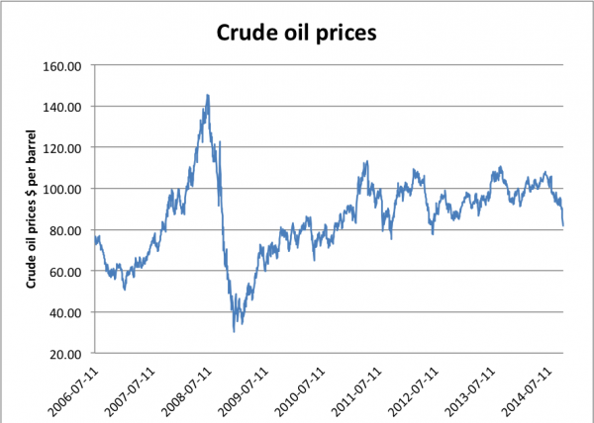
How Is the Change Detected?
A control chart is used. Its characteristics are:
  Time-oriented horizontal axis, Variable-of-interest vertical axis
Long-term usual variability is plotted as an upper and lower control limit around the long-term average.
A sample of size n is taken and the averages are plotted over time. If the plotted points are between the control limits, then the process is normal; if not, it needs to be adjusted.
TIMES PRO _ PROFESSINAL LEARNING

Slide 18

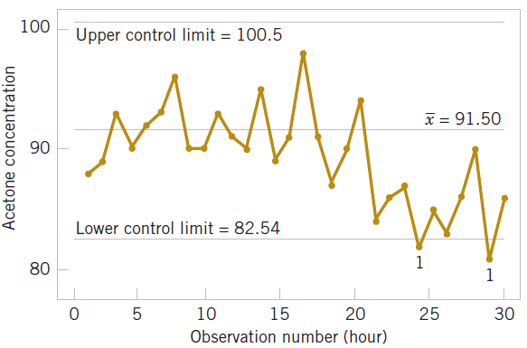
How Is the Change Detected Graphically?
The center line on the control chart is just the average of the concentration measurements for the first 20 samples.
when the process is stable. The upper control limit and the lower control limit are located 3 standard deviations of the concentration values above and below the center line
TIMES PRO _ PROFESSINAL LEARNING

Slide 19
Mechanistic and Empirical Models
A mechanistic model is built from our underlying knowledge of the basic physical mechanism that relates several variables.
Example: Ohm’s Law
Current = voltage/resistance
I = E/R
I = E/R + ε
where ε is a term added to the model to account for the fact that the observed values of current flow do not perfectly conform to the mechanistic model. The form of the function is known.
An empirical model is built from our engineering and scientific knowledge of the phenomenon, but is not directly developed from our theoretical or first-principles understanding of the underlying mechanism.
TIMES PRO _ PROFESSINAL LEARNING

Slide 20
An Example of an Empirical Model
We are interested in the numeric average molecular weight (M_{n}) of a polymer. Now we know that M_{n} is related to the viscosity of the material (V), and it also depends on the amount of catalyst (C) and the temperature (T ) in the polymerization reactor when the material is manufactured. The relationship between M_{n} and these variables is
M_{n} = f(V,C,T)
say, where the form of the function f is unknown.
We estimate the model from experimental data to be of the following form where the b’s are unknown parameters.
TIMES PRO _ PROFESSINAL LEARNING

Slide 21
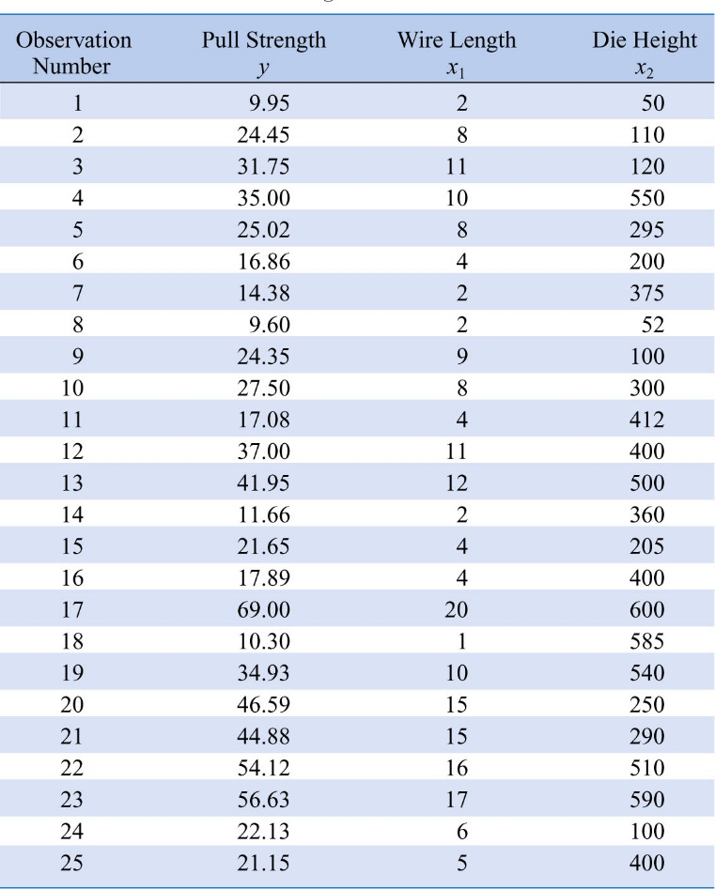
Example-ii
In a semiconductor manufacturing plant, the finished semiconductor is wire-bonded to a frame. In an observational study, the variables recorded were:
Pull strength to break the bond (y)
  Wire length (x₁)
  Die height (x₂)
In general, this type of empirical model is called a regression model.
The estimated regression relationship is given by:
Wire Bond Pull Strength Data
TIMES PRO _ PROFESSINAL LEARNING

